Slide 1
Triple P Tourism: Promotion, Policy and Pilots
Sarajevo, 28 June 2018

Slide 2


Slide 3
Triple P Tourism Promotion, Policy and Pilots:
Duration: 3 years (2018-2021)
Funds: € 5 million
RCC implemented - EU Funded
Regional Platform in Charge: RCC’s Tourism Expert Group (government and private sector)

Slide 4
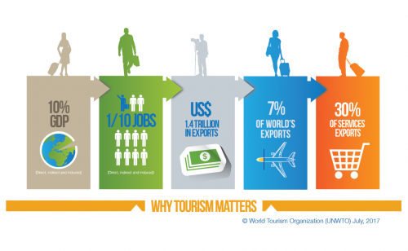
Why tourism?
continued expansion over 6 decades

Slide 5
What has RCC done thus far?
Established the WB Tourism Expert Group;
Contributed to the preservation of cultural heritage
Prioritised most competitive market niches for joint regional product development;
  cultural tourism,
  adventure tourism;
Launched 5-million euro worth project – Triple P Tourism
Notes:
which identified policy barriers hindering sector development and produced recommendations on how to overcome them
Contributed to the preservation of cultural heritage - sites through the RCC’s Task Force on Culture and Society (TFCS) (Ljubljana Process II)
Prioritised cultural tourism and adventure tourism as most competitive market niches for joint regional product development

Slide 6
Tourism in the SEE – Western Balkans Six
continued growth over the past decade
recognised as priority sector
Fragmented offer
low government spending on tourism development (less than 2% on average)
regional routes still insufficiently developed and low in number
administrative barriers to free flows of tourist
business environment inadequately developed
GDP contribution: 5.6% direct and
14.7% indirect
Employment contribution: 5.4% direct and
14% indirect
Exports contribution: 24.1%

Slide 7
Tourism in the SEE – Western Balkans Six
72% of population sees regional cooperation as strong contributor to political and economic stability
56% of businesses see regional cooperation of high importance for success of their businesses.

Slide 8
What will Triple P Tourism project do?
RCC’s Tourism Expert Group:
  implementation framework
  develop recommendations for solutions to policy challenges and barriers that hinder regional sector development
  Lead sector specific measures in the context of SEE 2020 strategy implementation

Slide 9
What will Triple P Tourism project do?
joint internationally competitive regional routes
  Regional Brand: “ Western Balkans - Crossroads of Civilizations”
  Culture: Archeological sites, WWII monuments, fortifications and fortresses
  Adventure: Via Dinarica
improve QUALITY and consolidate fragmented product
  share BEST PRACTICES
  public-private DIALOGUE and PARTNERSHIPS
generate SALES and INCOME
create EMPLOYMENT opportunities

Slide 10
What will Triple P Tourism project do?
policy SOLUTIONS to enhance cooperation and travel
Improve tourism INFRASTRUCTURE through small grants facility
Foster PPP in provision of services and SITE MANAGEMENT

Slide 11
What will Triple P Tourism project achieve?
introduce at least two competitive regional routes to international markets
maintain double digit growth in tourism arrivals and overnights
grow sales and income from exports
create new employment in tourism
Create jobs at place of living
provide solutions to key barriers to growth
promote responsible and sustainable tourism development solutions
maintain and expand regional cooperation platform

Slide 12

Thank you!
Regional Cooperation Secretariat
Trg Bosne i Hercegovine 1/V
71000 Sarajevo, Bosnia and Herzegovina
Tel: +387 33 561 700
Fax: +387 33 561 701
Mob: +387 61 190 601
www:rcc.int
Twitter:@rcccint
Facebook:RegionalCooperationCouncil
YouTube:RCCSec

